Slide 1
Conditional Probability – Including Partial Information
CS2402 Lecture 9

Slide 2
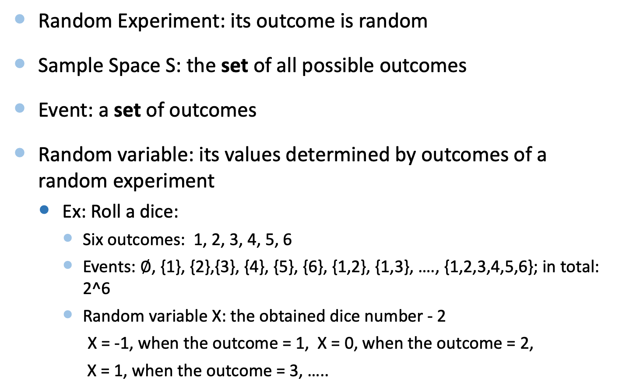
Concepts
Random Experiment: its outcome is random
Sample Space S: the set of all possible outcomes
Event: a set of outcomes
Random variable: its values determined by outcomes of a random experiment
Ex: Roll a dice:
Six outcomes: 1, 2, 3, 4, 5, 6
Events: $∅$, {1}, {2},{3}, {4}, {5}, {6}, {1,2}, {1,3}, …., {1,2,3,4,5,6}; in total: 2^6
Random variable X: the obtained dice number - 2
X = -1, when the outcome = 1, X = 0, when the outcome = 2,
X = 1, when the outcome = 3, …..

Slide 3
Probability
The probability of an event is the relative frequency of occurrence in the experiment
Probability of event E is
P(E) =
The value of P is between 0 and 1, inclusive
Assume that each outcome has the same relative frequency
The sample space
number of outcomes in E
event E
total number of possible outcomes

Slide 4
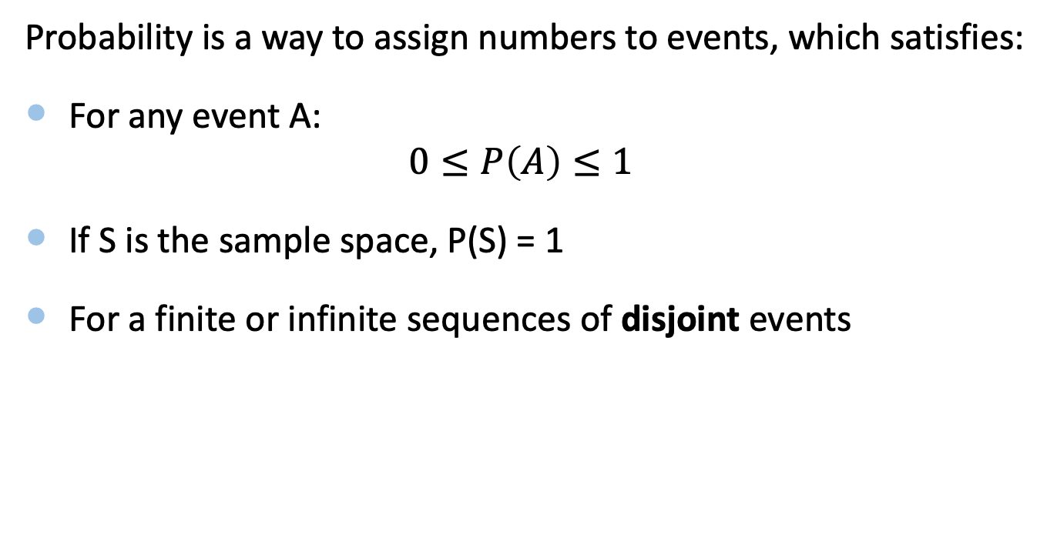
Math Definition of Probability
Probability is a way to assign numbers to events, which satisfies:
For any event A:
$$0≤P\left(A\right)≤1$$
If S is the sample space, P(S) = 1
For a finite or infinite sequences of disjoint events

Slide 5
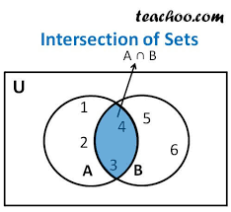
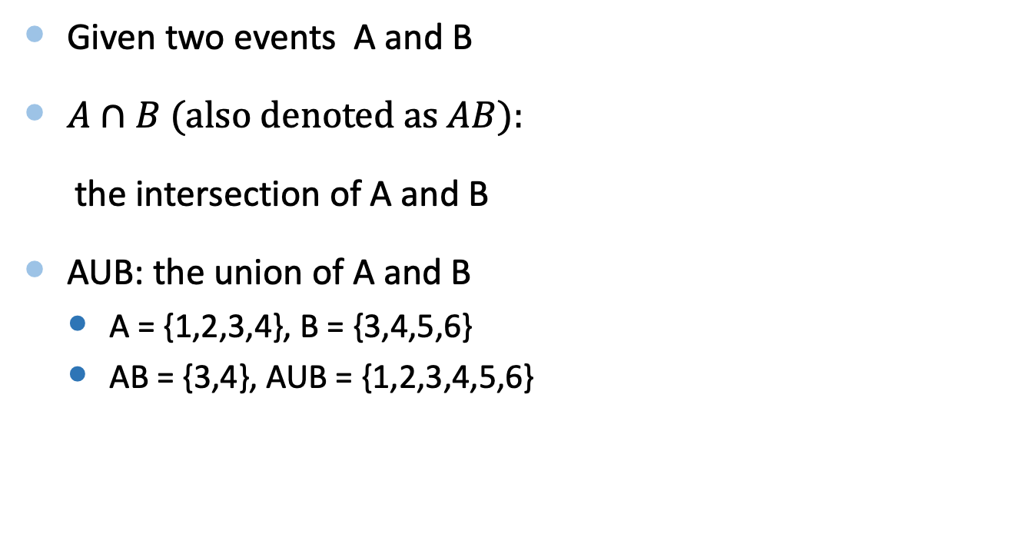
Set Operation
Given two events A and B
$A∩B (also denoted as AB):$
the intersection of A and B
AUB: the union of A and B
A = {1,2,3,4}, B = {3,4,5,6}
AB = {3,4}, AUB = {1,2,3,4,5,6}

Slide 6
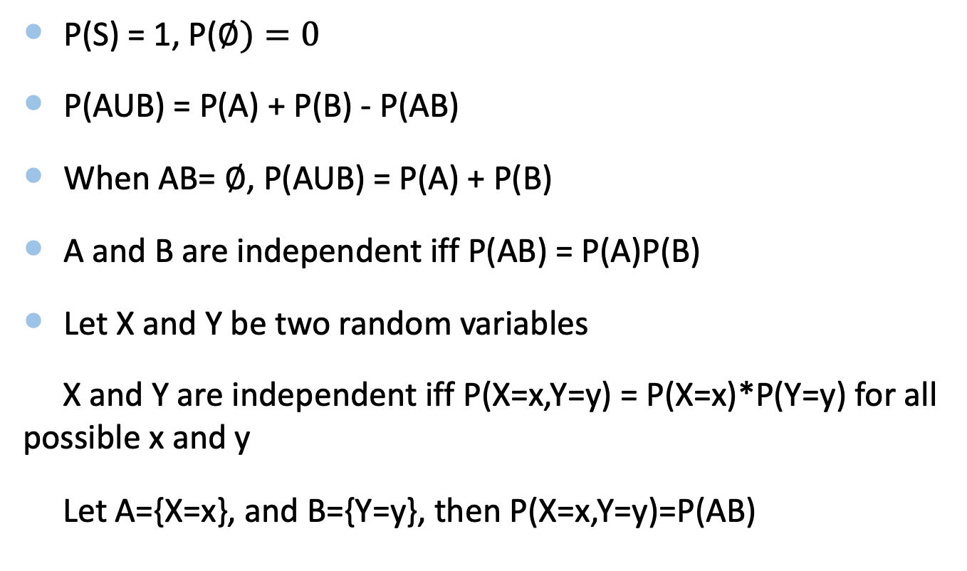
Probability of Events
P(S) = 1, P($∅)=0$
P(AUB) = P(A) + P(B) - P(AB)
When AB= $∅$, P(AUB) = P(A) + P(B)
A and B are independent iff P(AB) = P(A)P(B)
Let X and Y be two random variables
X and Y are independent iff P(X=x,Y=y) = P(X=x)*P(Y=y) for all possible x and y
Let A={X=x}, and B={Y=y}, then P(X=x,Y=y)=P(AB)

Slide 7
Objectives
Conditional Probability
Independence and Multiplication Rule
Monty Hall Problem
Summary

Slide 8
Conditional Probability
Conditional probability provides a way to include partial information
Examples:
Rolling a dice – given that the roll was even, what is the probability that the roll was a 6?
Word Guessing – given that the first letter is “t”, what is the probability that the second letter is “h”?
Here the new information is the “given” event
Update current probabilities with partial information
Allow us to reason with partial information

Slide 9
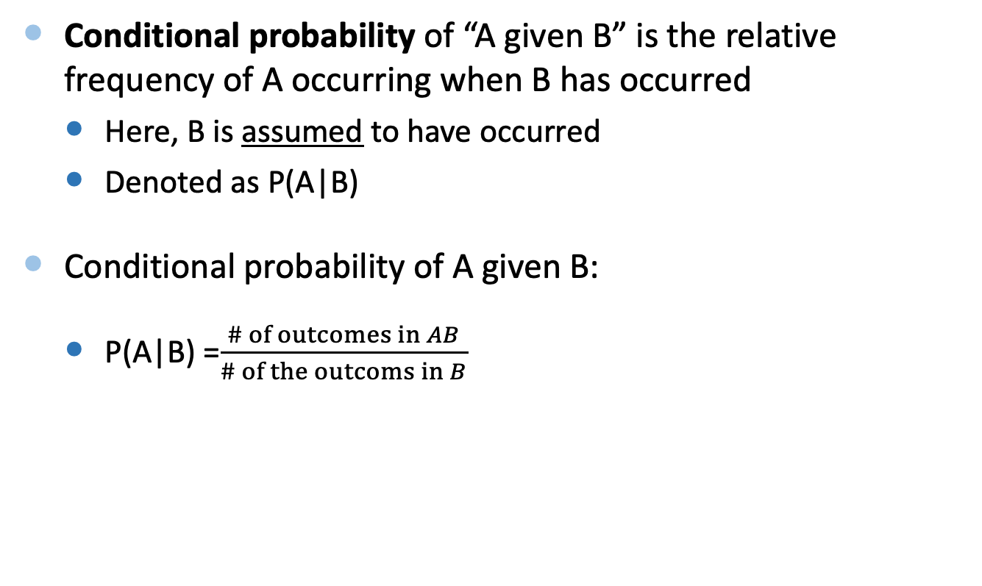
Conditional Probability: When Each Outcome Has the Same Probability
Conditional probability of “A given B” is the relative frequency of A occurring when B has occurred
Here, B is assumed to have occurred
Denoted as P(A|B)
Conditional probability of A given B:
P(A|B) =$\frac{\# of outcomes in AB}{\# of the outcoms in B}$
“given”

Slide 10
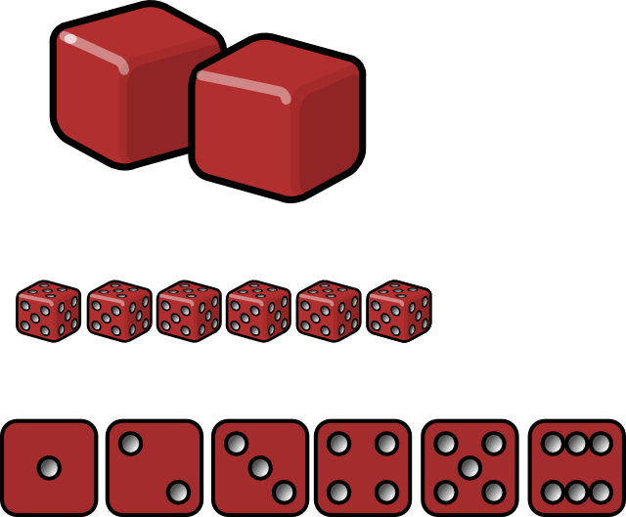
Example
Rolling a dice – “given that the roll was even, what is the probability that the roll was a 6?”
A: the roll was 6, A = {6}
B: the roll was even, B={2,4,6}
AB: {6}
P(roll was 6 | roll was even) = P(A|B) =
# of outcomes in AB / # of outcomes in B = 1/3
“6 and even”
“even”

Slide 11
Example
Suppose A: the roll = even, B: the roll > 2
What is P(A|B)?
A = {2,4,6}, B = {3,4,5,6}, AB = {4,6}
P(A|B) = 2/4 = 1/2
P(B|A) = 2/3

Slide 12
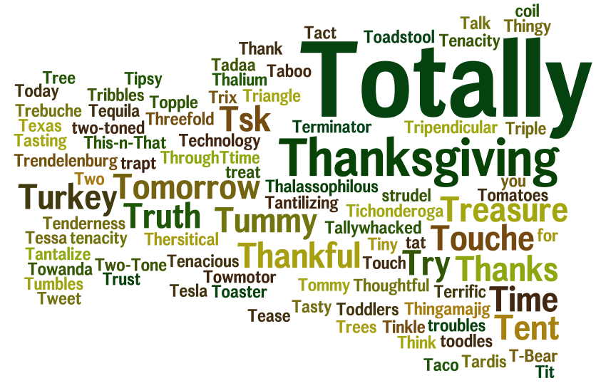
Example
Word Guessing – “given that the first letter is ‘t’, what is the probability that the second letter is ‘h’?”
# words that start with “th”: 1175
# words that start with “t”: 8782
P(2nd letter is “h” | 1st letter is “t”) = 1175/8782 = 13.4%
Source: http://www.morewords.com

Slide 13
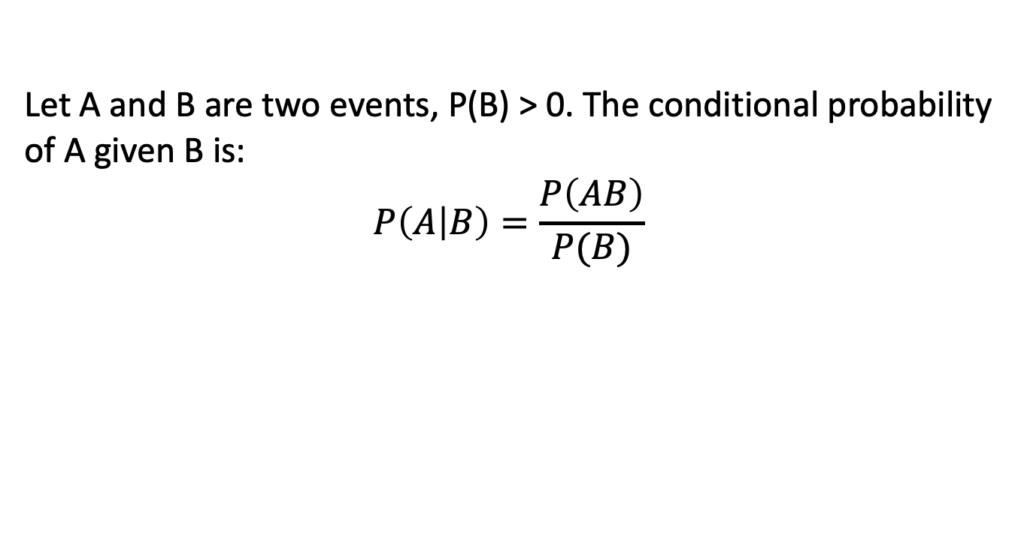
Conditional Probability in General
Let A and B are two events, P(B) > 0. The conditional probability of A given B is:
$$P\left(A | B\right)=\frac{P\left(AB\right)}{P(B)}$$

Slide 14


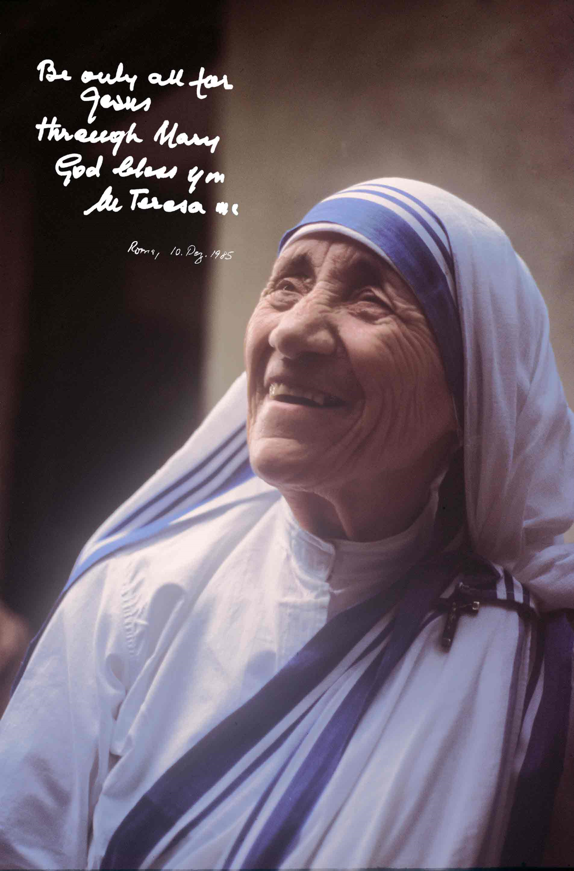
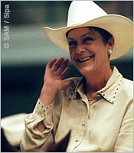
Example: Rich & Famous
Example: Rich & Famous
In a certain town, 10% of
the inhabitants are rich,
5% are famous, and
3% are rich and famous
Neither
Famous
Rich
If a town’s person is chosen at random and she is rich what is the probability she is famous?

Slide 15
Example: Rich & Famous
Example: Rich & Famous
In a certain town, 10% of
the inhabitants are rich,
5% are famous, and
3% are rich and famous
Neither
Famous
Rich
P(R) = 0.1
P(RF) = 0.03
P(F|R) = 0.03/0.1 = 0.3

Slide 16
Disease Example Revisited
Given a positive test result, what is the probability that you have the disease?
P(tested positive and have Disease) = 2%
P(tested positive) = 2% + 3% = 5%
P(have the disease | tested positive) = 2% / 5% = 40%
Test Result
Positive
Negative
Have Disease
Yes
2% | 0.1%
3% | 94.9%
No
5%
P(tested positive)

Slide 17
Objectives
Conditional Probability
Independence and Multiplication Rule
Monty Hall Problem
Summary

Slide 18
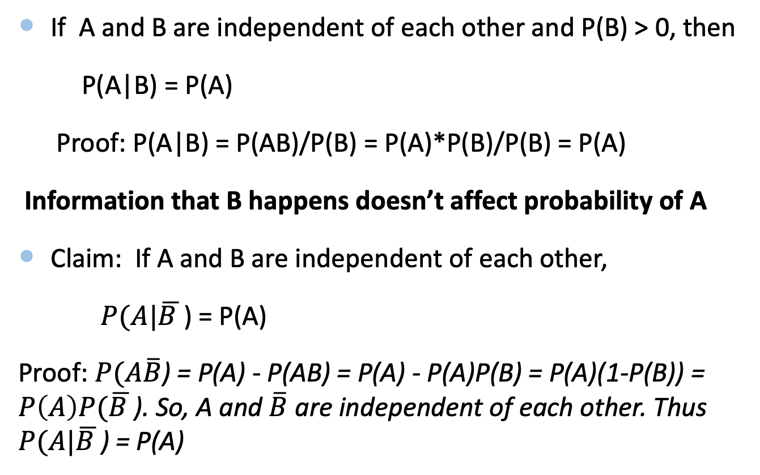
Independence Revisited
If A and B are independent of each other and P(B) > 0, then
P(A|B) = P(A)
Proof: P(A|B) = P(AB)/P(B) = P(A)*P(B)/P(B) = P(A)
Information that B happens doesn’t affect probability of A
Claim: If A and B are independent of each other,
$P(A|\overline{B }$) = P(A)
Proof: $P(A\overline{B}$) = P(A) - P(AB) = P(A) - P(A)P(B) = P(A)(1-P(B)) = $P\left(A\right)P(\overline{B }$). So, A and $\overline{B}$ are independent of each other. Thus $P(A|\overline{B }$) = P(A)

Slide 19
Multiplication Rule
For all events A and B such that P(B)>0:
P(AB) = P(B)P(A|B)

Slide 20
Box then ball
Consider the following experiment:
We first pick one of the two boxes:
A B
and next we pick a ball from the box that we picked
Question: What’s the probability of getting a 2?
1
3
5
2
4

Slide 21
Tree Diagram
P(A) = 1/2
P(B) = 1/2
1
3
5
2
4
P(1|A) = 1/3
P(2|B) =1/2
1/3
1/3
1/3
1/2
1/2
1
3
5
2
4
1/6
1/6
1/6
1/4
1/4
P(2) = P({2}$∩$B) = P(B)*P(2|B) = 1/2*1/2 = 1/4

Slide 22
Box then ball
Consider the following experiment:
We first pick one of the two boxes:
A B
and next we pick a ball from the box that we picked
Question: What’s the probability of getting a number smaller than 3.5?
1
3
5
2
4

Slide 23
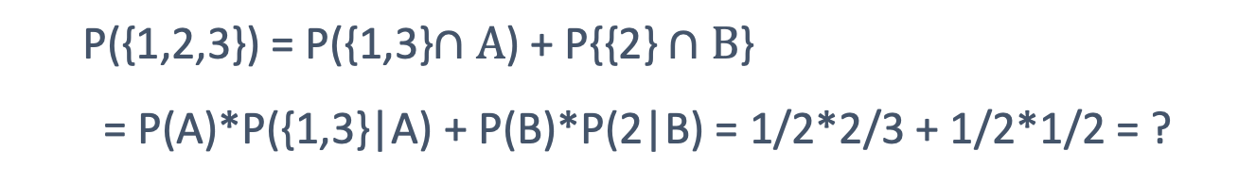
P(A) = 1/2
P(B) = 1/2
1
3
5
2
4
P(1|A) = 1/3
P(2|B) =1/2
1/3
1/3
1/3
1/2
1/2
1
3
5
2
4
1/6
1/6
1/6
1/4
1/4
P({1,2,3}) = P({1,3}$∩A$) + P{{2} $∩B$}
= P(A)*P({1,3}|A) + P(B)*P(2|B) = 1/2*2/3 + 1/2*1/2 = ?

Slide 24
Objectives
Conditional Probability
Independence and Multiplication Rule
Monty Hall Problem
Summary

Slide 25

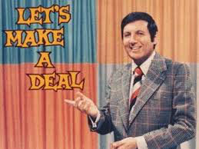

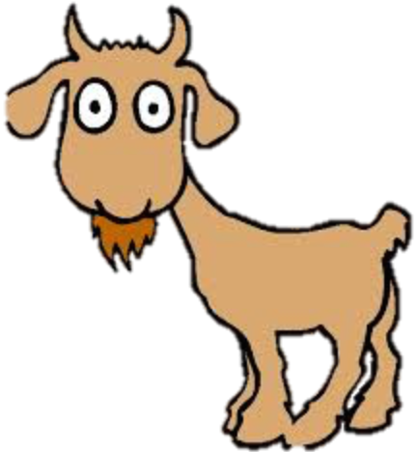

Monty Hall Problem
You are on a TV game show
There are 3 closed doors, and you can pick one
A car is randomly placed behind one door
Goats are behind the two other doors
You pick door number 1
1
2
3
Notes:
http://marilynvossavant.com/game-show-problem/
http://xkcd.com/1282/
21 movie: https://www.youtube.com/watch?v=cXqDIFUB7YU&feature=kp
and various solutions
mythbusters: https://www.youtube.com/watch?v=-XWLynrvTzE#t=772

Slide 26
Monty Hall Problem
The host will open one of the other doors (2 or 3) to reveal a goat
If both doors have goats, the host will randomly pick a door to open
Suppose the host opens Door 3, revealing a goat
1
2
3
3
Notes:
http://marilynvossavant.com/game-show-problem/
http://xkcd.com/1282/
21 movie: https://www.youtube.com/watch?v=cXqDIFUB7YU&feature=kp
and various solutions
mythbusters: https://www.youtube.com/watch?v=-XWLynrvTzE#t=772

Slide 27
Monty Hall Problem
Now the host offers you a choice:
Stick with your current Door 1 or switch to Door 2?
What is the probability that you will win by switching?
a) 33% b) 50% c) 66% d) 100%
(What is the probability that the car is behind Door 2?)
1
2
3
Notes:
http://marilynvossavant.com/game-show-problem/
http://xkcd.com/1282/
21 movie: https://www.youtube.com/watch?v=cXqDIFUB7YU&feature=kp
and various solutions
mythbusters: https://www.youtube.com/watch?v=-XWLynrvTzE#t=772

Slide 28
Answer
The best choice is to switch doors!
After the host opens a door, the probability that the car is behind the remaining door becomes 66.6%
This is counter-intuitive – our intuition is 50% probability for both closed doors
1
2
3
Probability of Car | 33.3% | 66.6% | 0%
Notes:
http://marilynvossavant.com/game-show-problem/
http://xkcd.com/1282/
21 movie: https://www.youtube.com/watch?v=cXqDIFUB7YU&feature=kp
and various solutions
mythbusters: https://www.youtube.com/watch?v=-XWLynrvTzE#t=772

Slide 29
Solution by Enumeration
Assume we pick Door 1, list out all scenarios
If car is picked first, you will lose by switching
If goat is picked first, you will win by switching (the 2nd goat is removed)
Since there are 2 goats, 66.6% chance of winning by switching
Door 1 (picked) | Door 2 | Door 3 | Result of Sticking | Result of Switching
Win Lose
Lose Win
Lose Win

Slide 30
Solution by Enumeration
Assume we pick Door 1, list out all scenarios.
P(win by switching) = 2/3
P(win by sticking) = 1/3
Door 1 (picked) | Door 2 | Door 3 | Result of Sticking | Result of Switching
 |  |  | Win | Lose
 |  |  | Lose | Win
 |  |  | Lose | Win

Slide 31
Intuitive Solution
P(car)
Before opening a door, each door has the same probability to win
66.6% probability that car is behind Doors 2 or 3
After opening Door 3,
The probability for Door 3 shifts to Door 2
33.3% | 33.3% | 33.3%
1
2
3
probability behind one of these doors is 66.6%
1
2
3
33.3% | 66.6% | 0%
P(car | Door 3 opened)
Notes:
http://marilynvossavant.com/game-show-problem/
http://xkcd.com/1282/
21 movie: https://www.youtube.com/watch?v=cXqDIFUB7YU&feature=kp
and various solutions
mythbusters: https://www.youtube.com/watch?v=-XWLynrvTzE#t=772

Slide 32
Thought Experiment
Imagine this variant:
There are 100 doors to pick from in the beginning. Only one car is behind them
You pick one door
Monty opened 98 other doors with goats
Should you stick to your current door or switch?

Slide 33
Solution by Conditional Probability
Assume we selected Door 1, and the host opened Door 3
Calculate the conditional probability of “Car behind Door 2 given Door 3 is opened”
P(car behind Door 2 | Door 3 opened ) =
P(car behind Door 2 and Door 3 opened)
P(Door 3 opened)
1
2
3
Notes:
http://marilynvossavant.com/game-show-problem/
http://xkcd.com/1282/
21 movie: https://www.youtube.com/watch?v=cXqDIFUB7YU&feature=kp
and various solutions
mythbusters: https://www.youtube.com/watch?v=-XWLynrvTzE#t=772

Slide 34
Solution by Conditional Probability
First calculate P(Door 3 opened)
Door 3 is opened only when there is a goat there
There are two possible configurations:
Hence, P(Door 3 opened) = 1/3 + 1/6 = 1/2
Door 1 (picked) | Door 2 | Door 3 (opened) | Probability
Here, the host randomly selects between Doors 2 and 3. So the probability that Door 3 is opened is half of 1/3
1/3
1/3 × 1/2 = 1/6
Notes:
http://marilynvossavant.com/game-show-problem/
http://xkcd.com/1282/
21 movie: https://www.youtube.com/watch?v=cXqDIFUB7YU&feature=kp
and various solutions
mythbusters: https://www.youtube.com/watch?v=-XWLynrvTzE#t=772

Slide 35
Solution by Conditional Probability
Calculate P(car behind Door 2 and Door 3 opened)
There are one possible configuration:
Hence, P(car behind Door 2 and Door 3 opened) = 1/3
Finally,
P(car behind Door 2 | Door 3 opened) = = 2/3
Door 1 (picked) | Door 2 | Door 3 (opened) | Probability
 |  |  | 1/3
1/3
1/2
Notes:
http://marilynvossavant.com/game-show-problem/
http://xkcd.com/1282/
21 movie: https://www.youtube.com/watch?v=cXqDIFUB7YU&feature=kp
and various solutions
mythbusters: https://www.youtube.com/watch?v=-XWLynrvTzE#t=772

Slide 36
Summary – Monty Hall
After the host opens the door, the probability that you will win by switching doors is 66.6%
This depends on information obtained during the game
The door that you first selected
The behavior of the host to open another door with a goat
1
2
3
P(Car | Door 3 opened)
33.3% | 66.6% | 0%
Notes:
http://marilynvossavant.com/game-show-problem/
http://xkcd.com/1282/
21 movie: https://www.youtube.com/watch?v=cXqDIFUB7YU&feature=kp
and various solutions
mythbusters: https://www.youtube.com/watch?v=-XWLynrvTzE#t=772

Slide 37

Summary – Monty Hall
Suppose Alice joins the game after the door was opened, and is allowed to pick a door
She knows nothing about which door you picked first
The probability of picking the correct door is 50%
Her probability of winning is less because she does not know the information about why Door 3 was opened!
1
2
3
P(Car)
50% | 50% | 0%
Notes:
http://marilynvossavant.com/game-show-problem/
http://xkcd.com/1282/
21 movie: https://www.youtube.com/watch?v=cXqDIFUB7YU&feature=kp
and various solutions
mythbusters: https://www.youtube.com/watch?v=-XWLynrvTzE#t=772

Slide 38
Summary
Conditional probability:
P(A|B) = P(AB)/P(B)
Independence and multiplication rule
P(AB) = P(A|B)*P(B)
If A and B are independent, then P(A|B) = P(A)
Monty Hall problem

